Slide 1
Branching and Merging (Git)
Muhammad Asaduzzaman
School of Computer Science
University of Windsor
Used content from the Pro Git book
https://git-scm.com/book/en/v2

Slide 2
Git Model
A Git repository contains four kinds of objects.
A blob (represent a file)
a tree (represent a directory)
a commit (represent a revision/snapshot of the repository)
a tag
Every object is uniquely identified by a 40 hex digit number, which is obtained by determining SHA-1 hash of its content

Slide 3
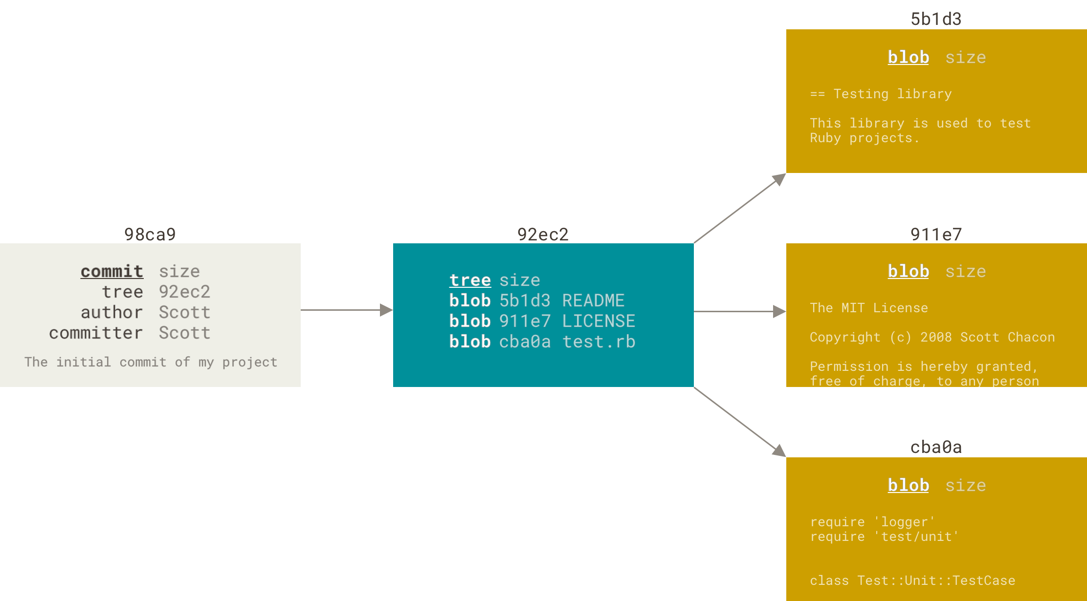
Git Model
$ git add README test.rb LICENSE
$ git commit -m 'Initial commit'

Slide 4
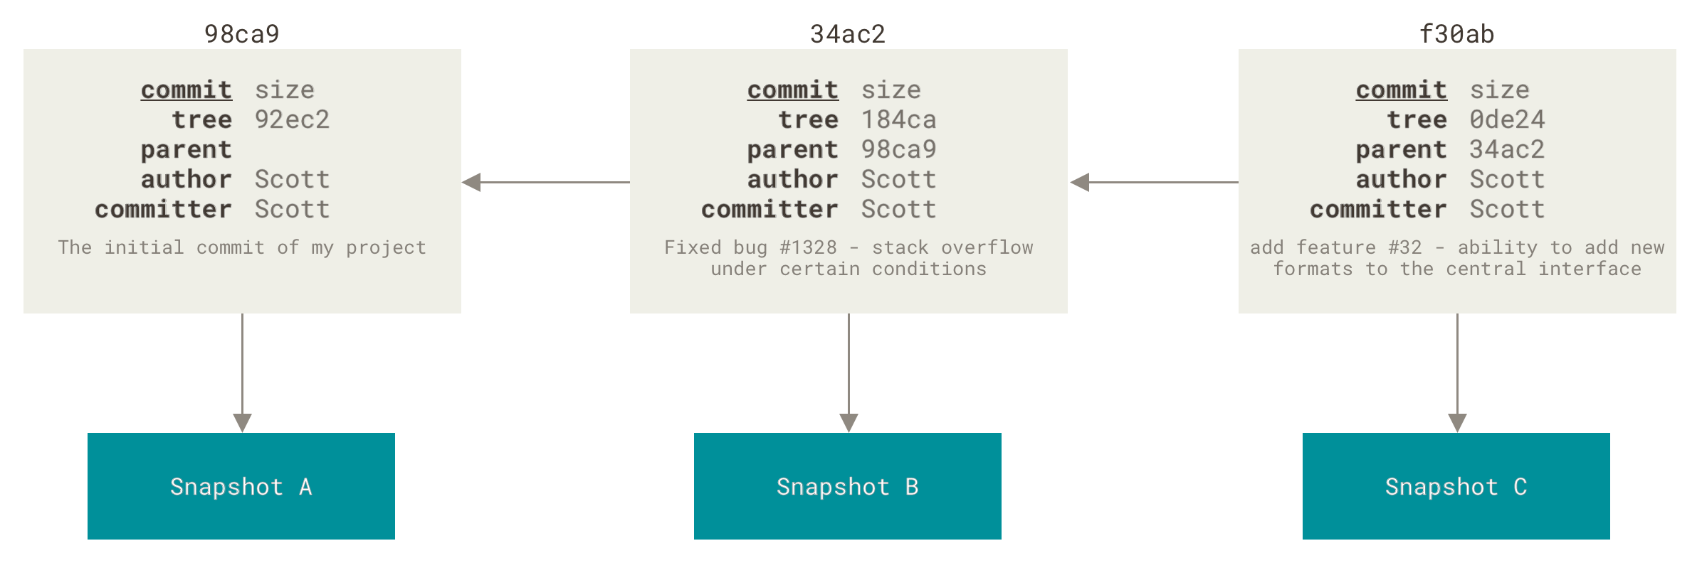
Git Model
If you create multiple commits, each commits stores a pointer that points to the commit before it.

Slide 5
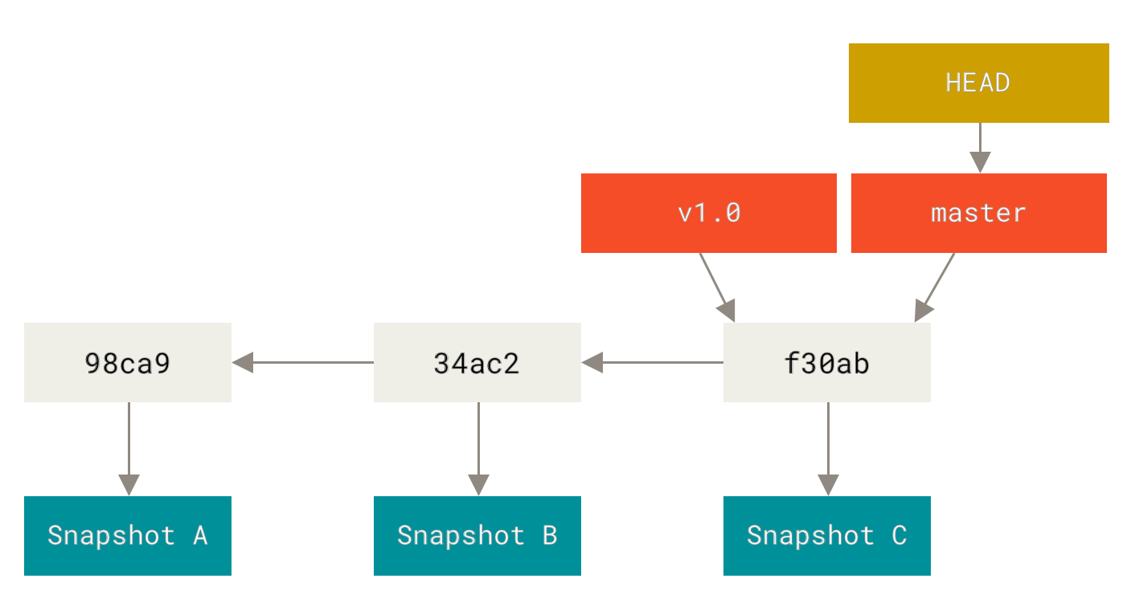
Git Model
A branch in Git is simply a lightweight movable pointer to one of these commits. The default branch name in Git is master
Notes:
As you start making commits, you’re given a master branch that points to the last commit you made. Every time you commit, the master branch pointer moves forward automatically.

Slide 6
Git Branching
A branch in Git is simply a lightweight movable pointer to one of these commits. The default branch name in Git is master
You can create a new branch by running the following command:
$ git branch v1.0
Notes:
git branch v1.0 command creates a new pointer to the same commit you’re currently on.

Slide 7
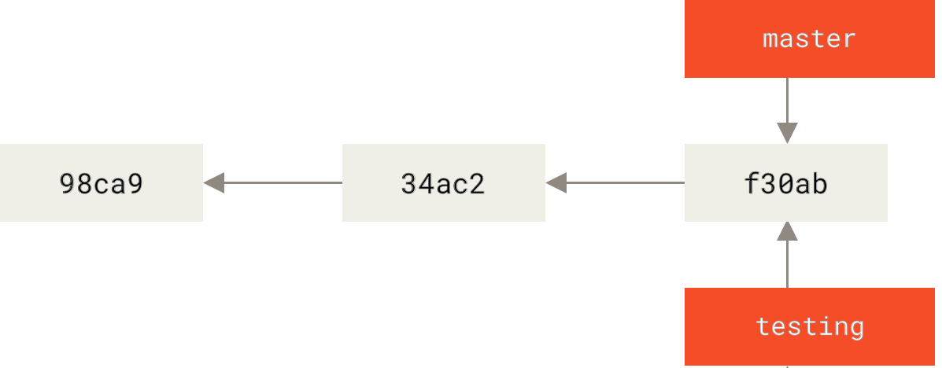
Git Branching
You can create a new branch by running the following command:
$ git branch testing
Notes:
git branch testing command creates a new pointer to the same commit you’re currently on.

Slide 8
Git Branching
You can create a new branch by running the following command:
$ git branch testing
How does git know which branch you are currently on?
Notes:
git branch v1.0 command creates a new pointer to the same commit you’re currently on.

Slide 9
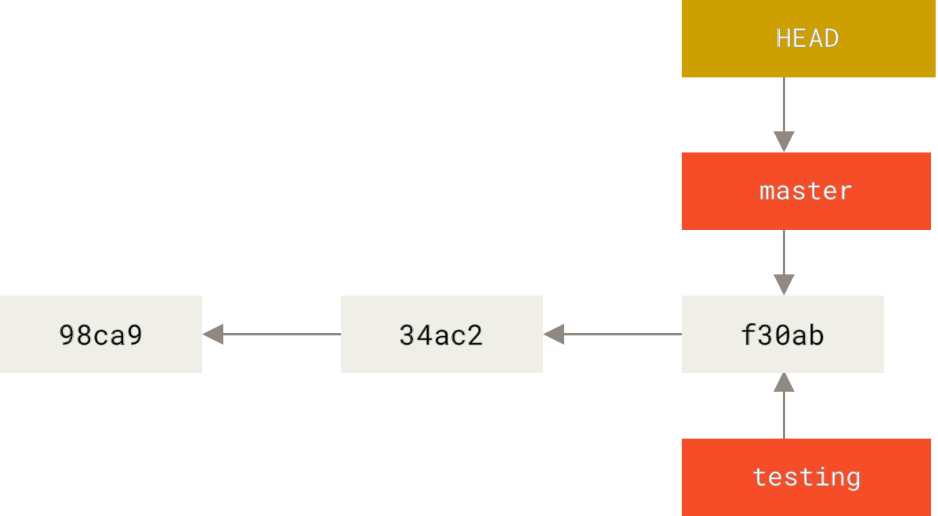
Git Branching
You can create a new branch by running the following command:
$ git branch testing
How does git know which branch you are currently on?
This is done using a special pointer, called HEAD
Notes:
The git branch command only created a new branch — it didn’t switch to that branch.

Slide 10
Git Branching
$ git log --oneline --decorate
f30ab (HEAD -> master, testing) Add feature #32 - ability to add new formats to the central interface
34ac2 Fix bug #1328 - stack overflow under certain conditions
98ca9 Initial commit
Notes:
The git branch command only created a new branch — it didn’t switch to that branch.

Slide 11
Git Branching
$ git log --oneline --decorate
f30ab (HEAD -> master, testing) Add feature #32 - ability to add new formats to the central interface
34ac2 Fix bug #1328 - stack overflow under certain conditions
98ca9 Initial commit
How to switch branches?

Slide 12
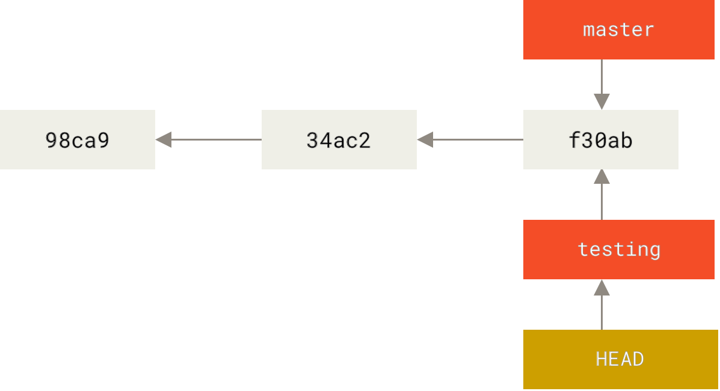
How to switch branches?
$ git checkout testing

Slide 13
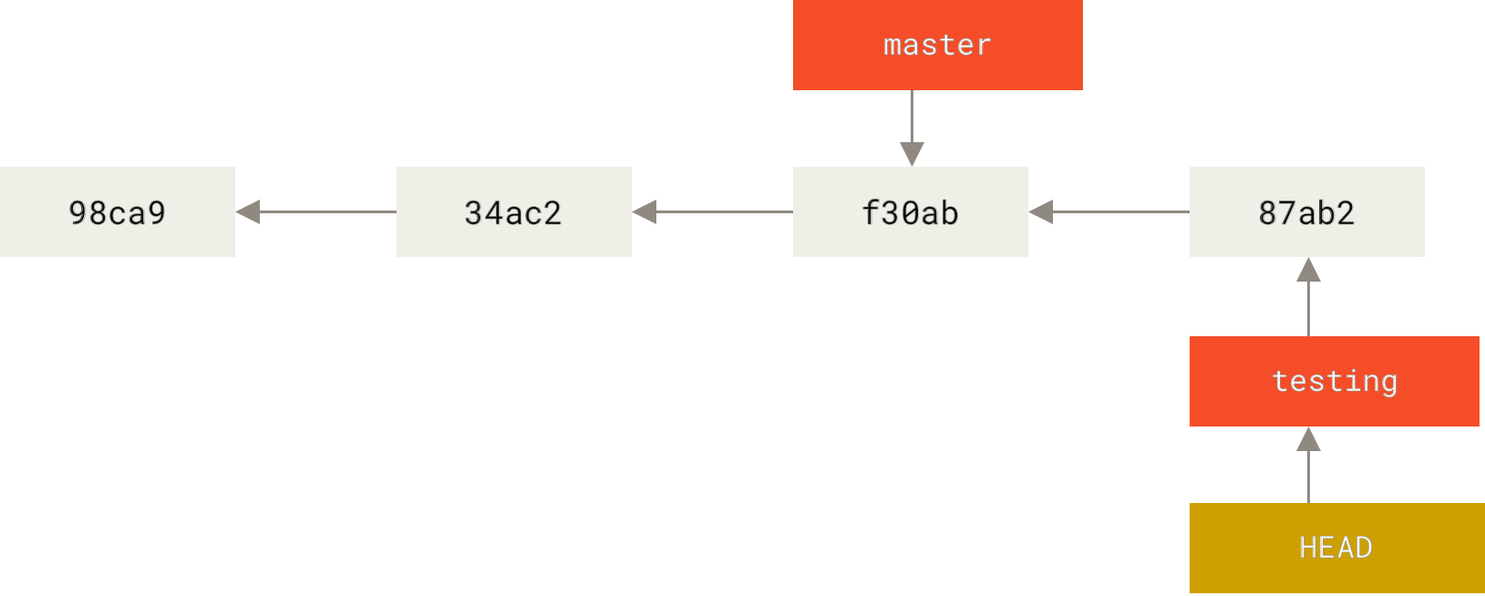
What if I make new changes
$ vim test.rb
$ git commit -a -m 'Make a change'
before commit
After commit

Slide 14
What if I make new changes
$ vim test.rb
$ git commit -a -m 'Make a change'
before commit
How to switch to the master branch?
After commit

Slide 15
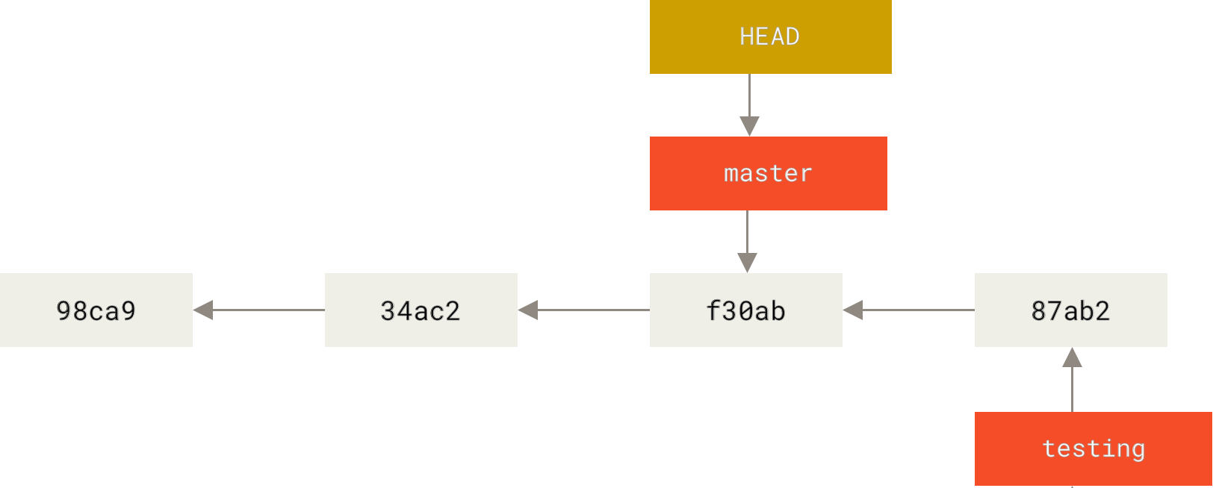
Let’s switch to the master branch
$ git checkout master

Slide 16
Let’s switch to the master branch
$ git checkout master
git log doesn’t show all the branches all the time
why?

Slide 17
Let’s switch to the master branch
$ git checkout master
git log doesn’t show all the branches all the time
git log testing or use git log --all

Slide 18
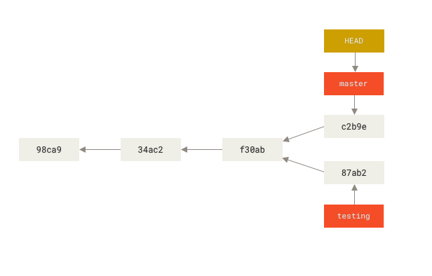
Let’s make a divergent change
$ vim test.rb
$ git commit -a -m 'Make other changes'
before commit
After commit

Slide 19
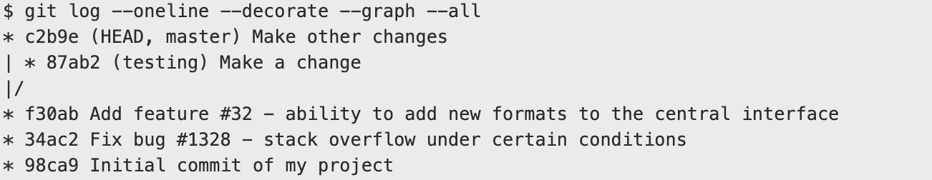
You can see divergent history easily
$ git log --oneline --decorate --graph --all

Slide 20
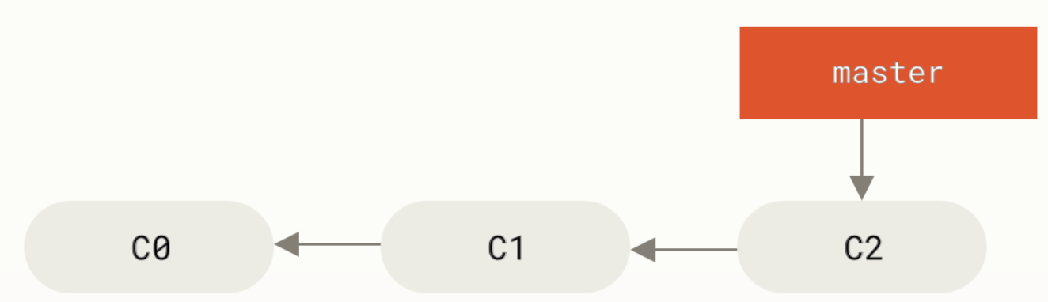
Basic Branching Example
Let’s say you are working on a project where you are building a website and you have already made some commits
Each commit is also known as a revision

Slide 21
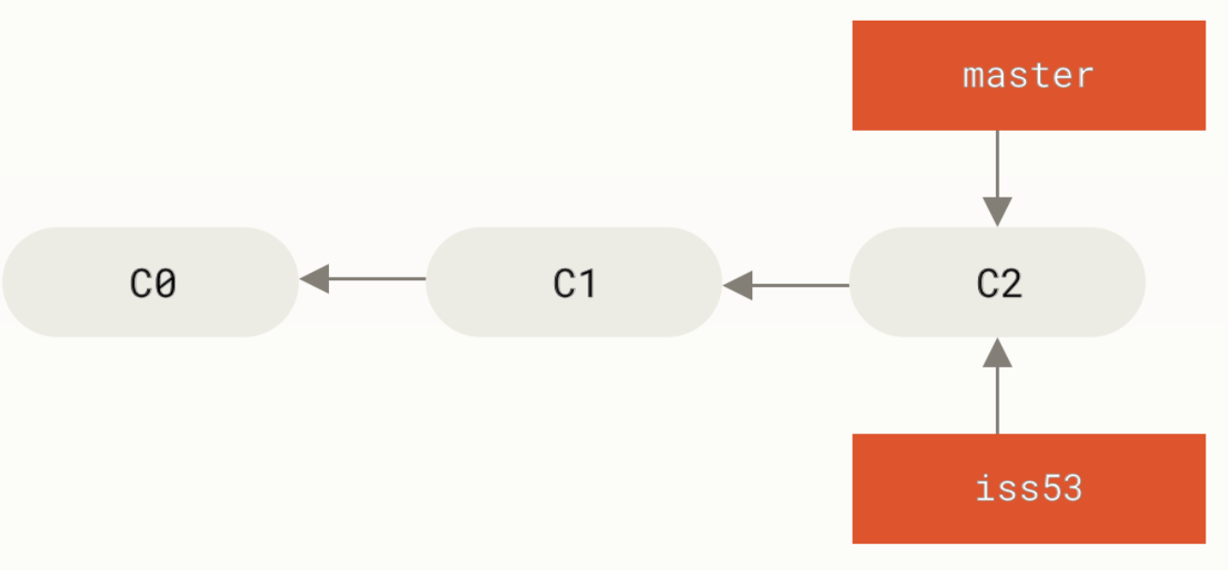
Basic Branching Example
$ git checkout -b iss53
Switched to a new branch "iss53"
Shortcut for
$ git branch iss53
$ git checkout iss53
You are in iss53 branch now

Slide 22
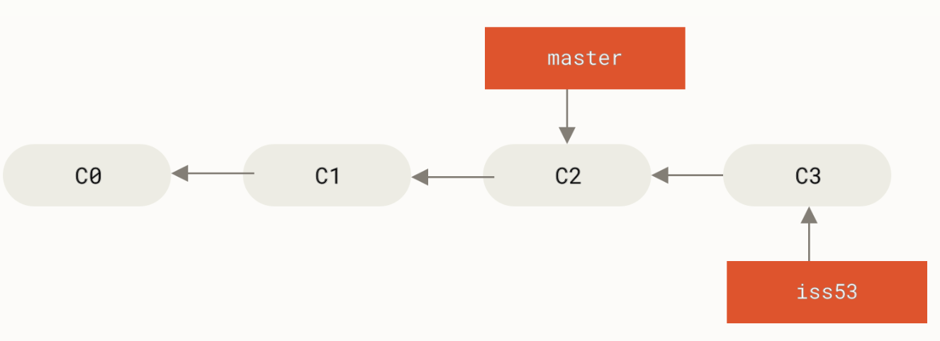
Basic Branching Example
$ vim index.html
$ git commit -a -m 'Create new footer [issue 53]'
You are in iss53 branch now

Slide 23
Basic Branching Example
before
$ git checkout master
Switched to branch 'master'
After

Slide 24
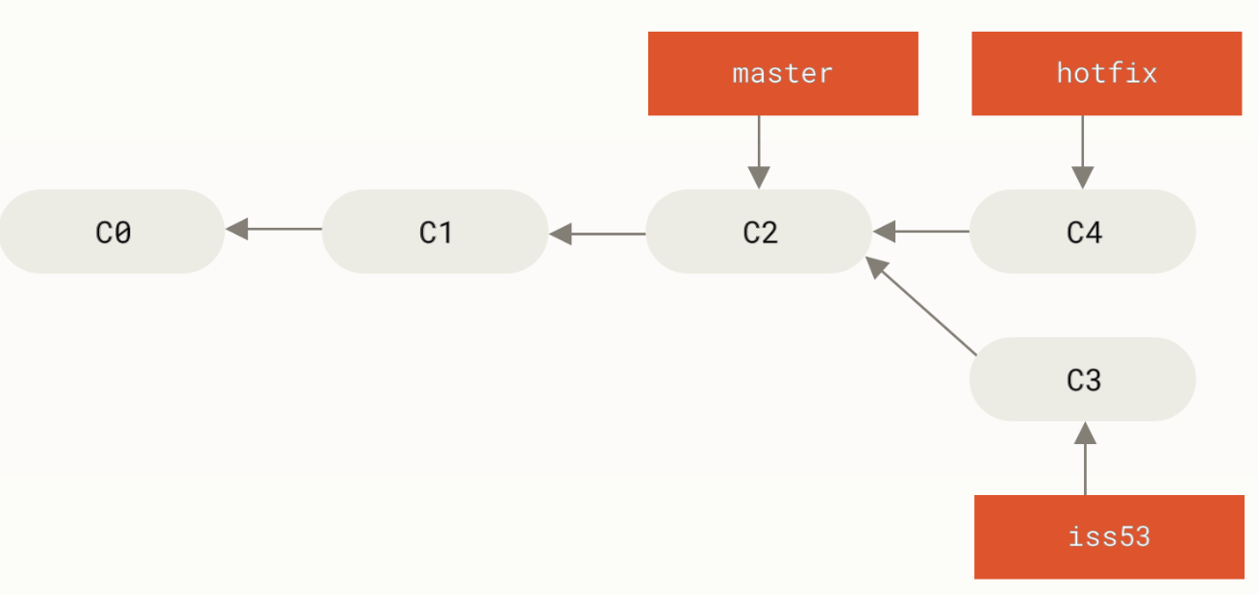
Basic Branching Example
before
$ git checkout -b hotfix
Switched to a new branch 'hotfix’
$ vim index.html
$ git commit -a -m 'Fix broken email address’
[hotfix 1fb7853]
Fix broken email address 1 file changed, 2 insertions(+)
After
After

Slide 25
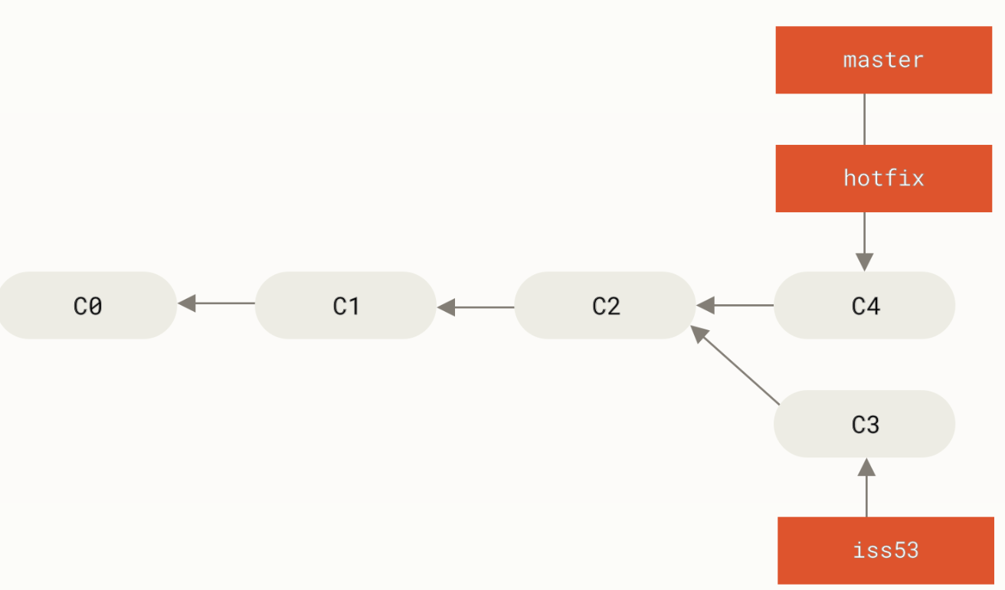
Basic Branching Example
before
$ git checkout master
$ git merge hotfix
Updating f42c576..3a0874c
Fast-forward index.html | 2 ++
1 file changed, 2 insertions(+)
After

Slide 26

Basic Branching Example
before
$ git branch -d hotfix
Deleted branch hotfix (3a0874c).
After

Slide 27
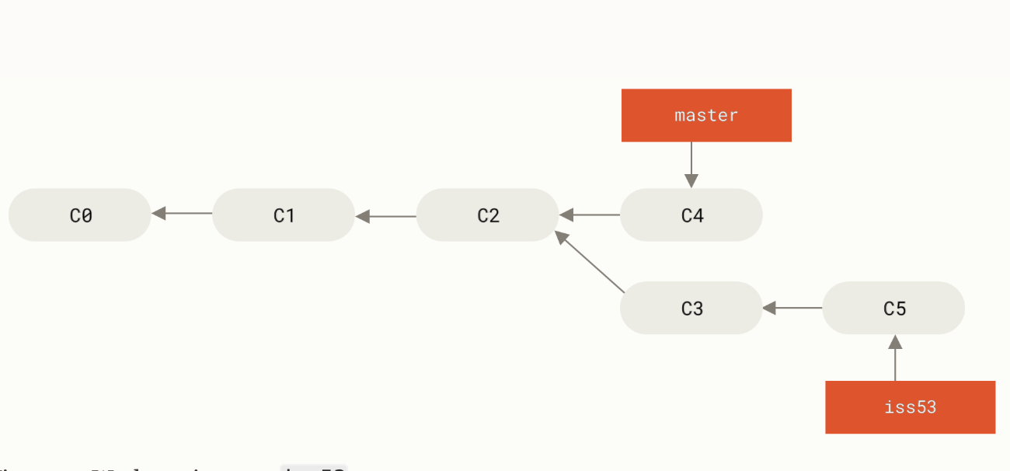
Basic Branching Example
$ git checkout iss53
Switched to branch "iss53"
$ vim index.html
$ git commit -a -m 'Finish the new footer [issue 53]’
[iss53 ad82d7a] Finish the new footer [issue 53]
1 file changed, 1 insertion(+)
before
$ git branch -d hotfix
Deleted branch hotfix (3a0874c).
After
before

Slide 28
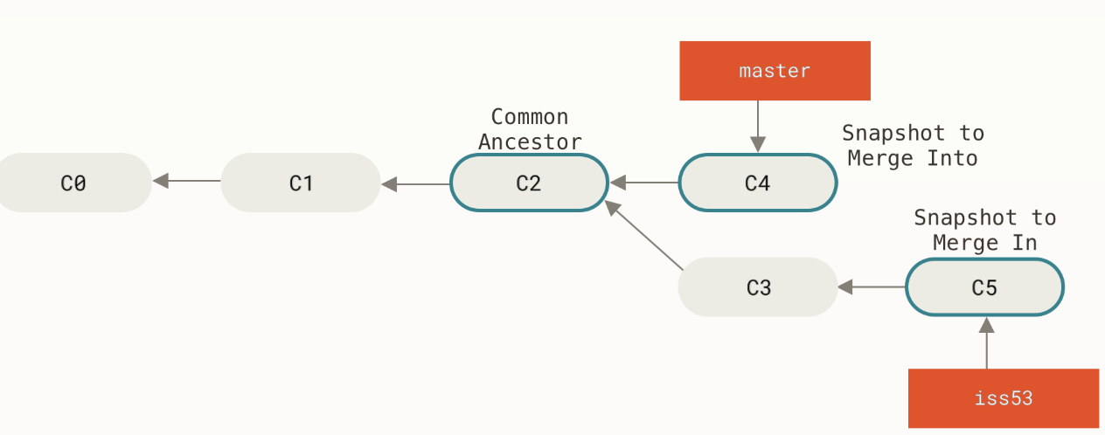

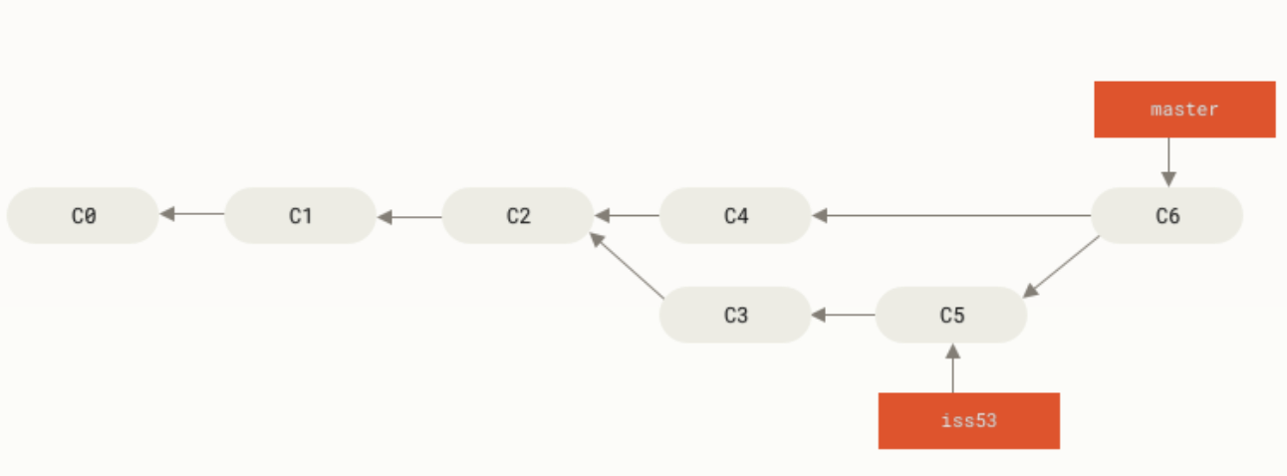


Basic Branching Example
before
$ git merge iss53
Merge made by the 'recursive' strategy. index.html
| 1 + 1 file changed,
1 insertion(+)
$ git checkout master Switched to branch 'master'
After

Slide 29
Basic Branching Example
before
$ git merge iss53
Merge made by the 'recursive' strategy. index.html
| 1 + 1 file changed,
1 insertion(+)
We can delete the branch iss53 now:
$ git branch -d iss53
After

Slide 30


Merge Conflict
Alice Local Revision: 5
Bob Local Revision: 5
Alice Local Revision: 5
Bob Local Revision: 5
Both checkout
Time: 12 pm
Server
Server Revision 5

Slide 31
Merge Conflict
Alice Local Revision: 5
Bob Local Revision: 5
Alice changes A.java file
and commit first
Alice Local Revision: 5
Bob Local Revision: 5
✔
Alice
Local Revision 6
Server
Both checkout
Time: 12 pm
Bob
Local Revision 5
Server
Server Revision 5

Slide 32
Merge Conflict
Alice Local Revision: 5
Bob Local Revision: 5
Alice changes A.java file
and commit first
Alice Local Revision: 5
Bob Local Revision: 5
✔
Alice
Local Revision 6
Server
Both checkout
Time: 12 pm
Bob
Local Revision 5
Server
Server Revision 5
Bob changes A.java file in
the same place and tries to commit
Bob
Local Revision 5
Server
Server Revision 6

Slide 33
Merge Conflict
Alice Local Revision: 5
Bob Local Revision: 5
Alice changes A.java file
and commit first
Alice Local Revision: 5
Bob Local Revision: 5
✔
Alice
Local Revision 6
Server
Both checkout
Time: 12 pm
Bob
Local Revision 5
Server
Server Revision 5
Bob changes A.java file in
the same place and tries to commit
Bob
Local Revision 5
Server

Server Revision 6

Slide 34
Merge Conflict
Alice Local Revision: 5
Bob Local Revision: 5
Alice changes A.java file
and commit first
Alice Local Revision: 5
Bob Local Revision: 5
✔
Alice
Local Revision 6
Server
Both checkout
Time: 12 pm
Bob
Local Revision 5
Server
Server Revision 5
Bob changes A.java file in
the same place and tries to commit
Conflict
Bob
Local Revision 5
Server

Server Revision 6

